Slide 1






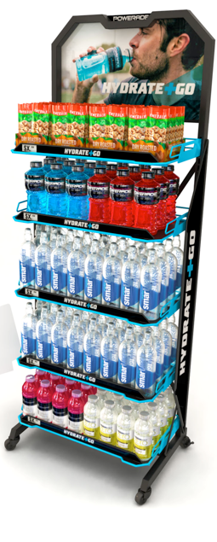
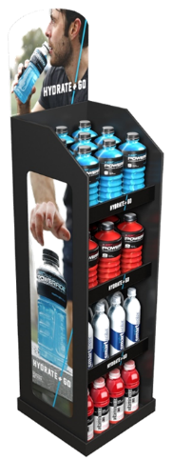

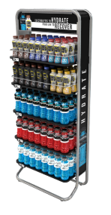
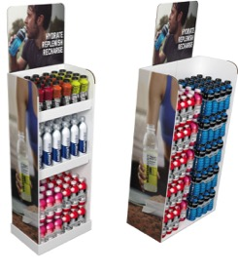
2018 OBBO Calendar – Large Store
Q1 2018
Q2 2018
Q3 2018
Q4 2018
Jan | Feb | Mar
Apr | May | Jun
Jul | Aug | Sep
Oct | Nov | Dec
Meals - Ready to Create (Pizza/Grilling/Pizza)
Meals – Breakfast
Meals – Fresh to Go
Meals – Ready to Serve
TBD Leisure
@Home Media – Movie Night
@Home Media – Sports Watching
Hydration Beauty (LS)
Hydration Wellbeing (LS)
Hydration Sports (LS)
Hydration Fitness for Life (LS)
Hydration Sports (CR)
Hydration Beauty (Drug)
Hydration Wellbeing/RX (Drug)

