Slide 1
HYDRATION OCCASION PATHWAYS: Convenience Retail

Slide 2









Hydration OBBOs 2018- Brands and Targets
HEALTH & WELLNESS / Leisure Away/@Home
ACTIVE LIFESTYLE / Leisure Away
BEAUTY
WELLBEING
SPORTS
FITNESS FOR LIFE
60%
50% ¹
active
40% ¹
40%
40% ¹
30% ¹
30% ¹
40% ¹
active
20% ¹
10%
20%
20% ²
Total # OBBOs = 12,000
Total # OBBOs = 18,000
Total # OBBOs = 15,000
Total # OBBOs = 10,000
1. Varies based by channel/OBBO
2. When execution “recover” phase

Slide 3





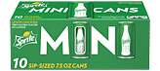
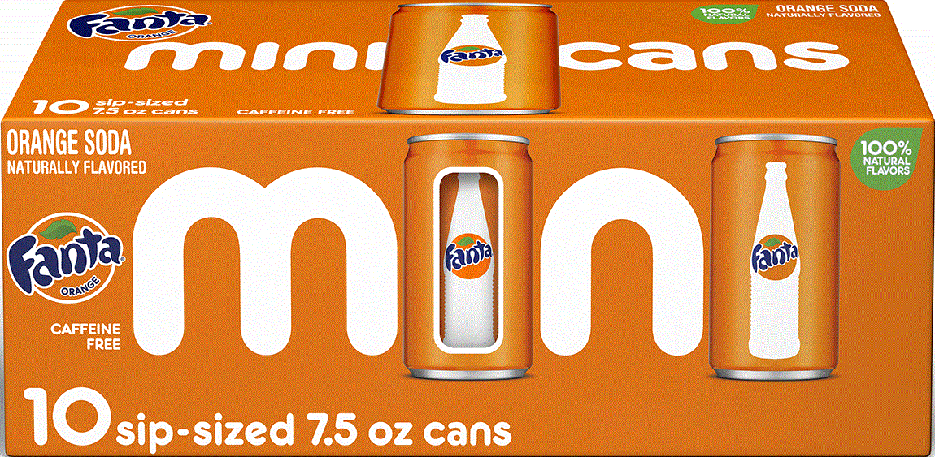
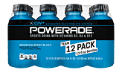
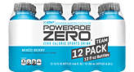
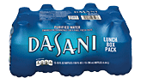
2018 OBBO Calendar- CR Channel
Q1 2018
Q2 2018
Q3 2018
Q4 2018
Jan | Feb | Mar
Apr | May | Jun
Jul | Aug | Sep
Oct | Nov | Dec
Meals - Ready to Create (Pizza/Grilling/Pizza)
Meals- Breakfast
Meals - Fresh to Go
Meals – Ready to Serve
TBD Leisure
@Home Media- Movie Night
@Home Media- Sports Watching
Hydration Beauty (LS)
Hydration Wellbeing (LS)
Hydration Sports (LS)
Hydration Sports (CR)
Hydration Beauty (Drug)
Hydration Wellbeing/Rx (Drug)
Best Accessible- Watermelon Stand
After School
Refreshment- Blaze Produce

Slide 4
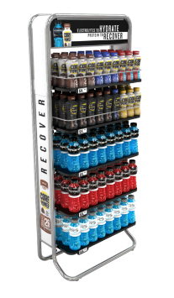
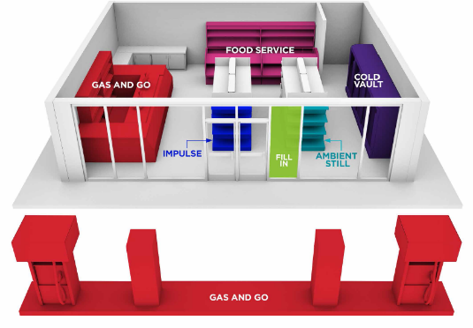
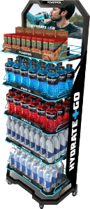
CR 2018 Sustaining PicOS
EMERGING / SEGMENTED POIs
Ambient Stills Perimeter
Secure incremental sustaining Hydration OBBO
5
1
2
3
2
4
4

Slide 5




Convenience Retail - Quarterly recommended Hydration OBBO activation
Jan-Mar 2018 |  | Apr-Jun 2018 |  | Jul-Sep 2018 | Oct-Dec 2018
Active Lifestyle/Sports OBBO Endcap Kit, Corrugate & Metal Rack (PA 32oz, vw 20oz, sw 700mL) |  | Active Lifestyle/Sports OBBO Endcap Kit, Corrugate & Metal Rack (PA 32oz, vw 20oz, sw 700mL) |  | Active Lifestyle/Sports OBBO Endcap Kit, Corrugate & Metal Rack (PA 32oz, vw 20oz, sw 700mL) | Active Lifestyle/Sports OBBO Endcap Kit, Corrugate & Metal Rack (PA 32oz, vw 20oz, sw 700mL)

Slide 6


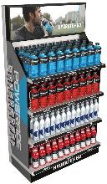
Hydration OBBO Convenience Retail: ACTIVE LIFESTYLE
ALL CREATIVE & PRODUCTS ARE FPO
Small Display
(Corrugate)
Permanent
(Metal)
Endcap Kit (36”)
(Corrugate/Plastic)
13” W x 13” D x 54” H (including 12” header)
62.5”h x 15.0”d x 25.5”w
36” W x 16” D x 54” H
Display ID
Material | Corrugate
Approx. Price | $70.73 (Q= 500)
Lead Time | 4-6 weeks
Pack out | (18) PA 32oz; (16) SW 20oz; (16) VW 20oz
Display ID
Material | Metal
Est. Price | $186.04 (4 casters an add’l $24.60)
Lead Time | 14-16 weeks
Pack out | (18) 32oz PA Bottles per shelf (21) 20oz VW Bottles per shelf (21) 700ml SW Bottles per shelf (4) 20oz PA 8 packs per shelf
Display ID
Material | Corrugate/Plastic
Approx. Price | $56.15(Q=500)
Lead Time | 6-8 weeks
Pack out | (72) PA 32oz singles (78) SW 20oz; (55) VW 20oz

Slide 7
HYDRATION Sports/Active LS pathway: convenience retail Q3 & Q4

Slide 8
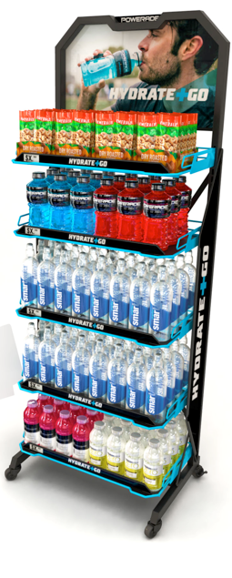
Hydration Active Lifestyle
Sports OBBO Large Store & CR: METAL MERCHANDISER
ALL CREATIVE & PRODUCTS ARE FPO
:
PROGRAM ELEMENTS
OBBO PLANOGRAM
Channel | Convenience Retail
Activation Timing | Year Round
In-Store Location Why | Perimeter at entrance,, Cashier, Beverages 9Billion Hydration trips a year 70 Fair Share Index
Occasion | Leisure Away
Adjacencies | Power bars / Healthy Snacks
How it Works | Drive incremental basket amount by offering multiple hydration solution for everyday Sport performer
Recommended Brands | Package | Suggested Retail Price | Pack count
Powerade | 32oz | $0.89 | 36
smartwater | 700mL | $1.79 | 32
Optional: VW | 20oz | $1.25 | 32
Tools: | Hydration Definition, Guidelines & Guardrails
Summer (July-Sept)
In-Market: 7/6/18
In-Plant: 6/25/18
Order Deadline: 2/9/18
Fall (Oct.-Dec.)
In-Market: 10/1/18
In-Plant: 9/17/18
Order Deadline: 5/4/18
Item Code: 1913897
(no casters)
Item Code: 1913898
(with casters)
Item Code: 1914420 (no casters)
Item Code: 1914421 (with casters)
68.5”h x 17.0”d x 26”w
Dynamic “Power Wedge” design
Printed shelf channel graphics
Matte black powder coat with gloss POWERADE blue accents
Screen printed side panel logos
Optional 2” caster wheels
Prices: $186.04 (No Casters) $210.64 (With Casters)
Notes:
Imai to brief Richard for flex rack, larger footprint with MPET
(Imai Comment) Done
Complete How it Works or delete if no value
(Imai Comment) Done
Add Tool row if relevant
(Imai Comment) No tool will be available for this OBBO

Slide 9
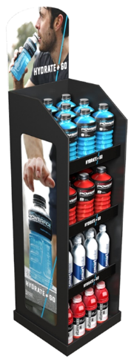
Hydration Active Lifestyle
Sports OBBO Convenience Retail: CORRUGATE DISPLAY
ALL CREATIVE & PRODUCTS ARE FPO
PROGRAM ELEMENTS
OBBO PLANOGRAM
Channel | Convenience Retail
Activation Timing | Year Round
In-Store Location Why | Perimeter at entrance, Cashier, Beverages 9Billion Hydration trips a year 70 Fair Share Index
Occasion | Leisure Away from home
Adjacencies | Power bars/ Healthy Snacks
How it Works | Drive incremental basket amount by offering multiple hydration solution for everyday Sport performer
Recommended Brands | Package | Suggested Retail Price | Pack count
Powerade | 32oz | $0.89 | 18
vitaminwater | 20oz | $1.25 | 16
smartwater | 20oz | $1.89 | 16
Tools: | Hydration Definition, Guidelines & Guardrails
Summer (July-Sept)
In-Market: 7/6/18
In-Plant: 6/25/18
Order Deadline: 2/9/18
Item code: 1914417
Fall (Oct.-Dec.)
In-Market: 10/1/18
In-Plant: 9/17/18
Order Deadline: 8/10/18
Item code: 1914422
13” W x 13” D x 54” H (including 12” header)
Corrugated unit housing single bottles
Interchangeable header and side panels
Price per 500 units: $70.73
*See appendix for all rack options
Notes:
Imai to brief Richard for flex rack, larger footprint with MPET
(Imai Comment) Done
Complete How it Works or delete if no value
(Imai Comment) Done
Add Tool row if relevant
(Imai Comment) No tool will be available for this OBBO

Slide 10
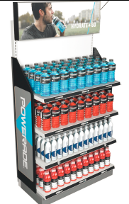
Hydration Active Lifestyle/Sports OBBO CR: END CAP DRESS KIT
ALL CREATIVE & PRODUCTS ARE FPO
PROGRAM ELEMENTS
18.5”(w) x 25.75”(d) x 56”(h)
OBBO PLANOGRAM
Channel | Convenience Retail
Activation Timing | Year Round
In-Store Location Why | Perimeter End Cap 9Billion Hydration trips a year 70 Fair Share Index
Occasion | Leisure Away from home
Adjacencies | Power bars / Jerky Beef
How it Works | Drive incremental basket amount by offering multiple hydration solution for everyday Sport performer
Recommended Brands | Package | Suggested Retail Price | Pack count
Powerade | 32oz | $0.89 | 72
vitaminwater | 20oz | $1.25 | 55
smartwater | 20oz | $1.89 | 78
Tools: | Hydration Definition, Guidelines & Guardrails
Summer (July-Sept)
In-Market: 7/6/18
In-Plant: 6/25/18
Order Deadline: 2/9/18
Item Code: 1914418
Fall (Oct.-Dec.)
In-Market: 10/1/18
In-Plant: 9/17/18
Order Deadline: 8/10/18
Item code: 1914423
36” W x 16” D x 54” H
Dress-up kit for existing 3ft endcap
Semi-transparent side panel attached to slotted uprights
Removable plastic header with channel for graphic insert
Shelf strips insert with messaging
Plastic and corrugate substrate
Price per 500 units: $56.15
*See appendix for all rack options
Notes:
Imai to brief Richard for flex rack, larger footprint with MPET
(Imai Comment) Done
Complete How it Works or delete if no value
(Imai Comment) Done
Add Tool row if relevant
(Imai Comment) No tool will be available for this OBBO

Slide 11
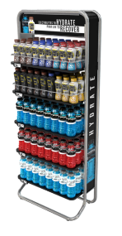
Hydration Active Lifestyle
Sports OBBO Large Store: HYDRATE & RECOVER DISPLAY
ALL CREATIVE & PRODUCTS ARE FPO
PROGRAM ELEMENTS
OBBO PLANOGRAM
Channel | Large Store
Activation Timing | Sustaining – while supplies last
In-Store Location Why | Perimeter at entrance, Produce, Beverages 9Billion Hydration trips a year 70 Fair Share Index
Occasion | Leisure Away
Adjacencies | Fresh Produce / Granola Bars / Entrance
How it Works | Drive incremental basket amount by offering multiple hydration solution for everyday Sport performer
Recommended Brands | Package | Suggested Retail Price | Pack count
Powerade | 32oz | $5.99 | 54
Core Power | 11.5oz | $2.99 | 48
Core Power Elite | 14oz | $3.49 | 24
Tools: | Hydration Definition, Guidelines & Guardrails
AVAILABLE NOW – WHILE SUPPLIES LAST
Item code: 1908524
Cost: $85.00 per unit (subsidized)
Description:
Silver steel frame
5 flat black steel shelves
Price channel on front of shelves
Changeable header and side signs
Anti-tip foot extension
26.25”W X 12.75”D x 62”H
*See appendix for all rack options
Notes:
Imai to brief Richard for flex rack, larger footprint with MPET
(Imai Comment) Done
Complete How it Works or delete if no value
(Imai Comment) Done
Add Tool row if relevant
(Imai Comment) No tool will be available for this OBBO

Slide 12
CR STORE - Hydration OBBO Sports/Active LS Q3 '18
Item Code | Item Description | Order Deadline Date | Estimated List Price per Pack
1914417 | Still Racks/Displays (Small Corrugate OBBO Display - interchangeable header and side panels) | 5/18/18 | $70.73
1914418 | Still Racks/Displays (CR 36inch End Cap Dress Up Kit - interchangeable header and side panels) | 5/18/18 | $56.15
1913897 | Still Racks/Displays (Hydration Sports OBBO - Metal Powerwedge unit - NO CASTERS) | 2/9/18 | $186.04
1913898 | Still Racks/Displays (Hydration Sports OBBO - Metal Powerwedge unit - CASTERS INCLUDED) | 2/9/18 | $210.64
1908524 | Rack (Hydrate & Recover NEW POWERHOUSE Merchandiser) | While Suppliers Last | $85.00

Slide 13
CR STORE - Hydration OBBO Sports/Active LS Q4 '18
Item Code | Item Description | Order Deadline Date | Estimated List Price per Pack
1914422 | Still Racks/Displays (Small Corrugate OBBO Display - interchangeable header and side panels) | 8/10/18 | $70.73
1914423 | Still Racks/Displays (CR 36inch End Cap Dress Up Kit - interchangeable header and side panels) | 8/10/18 | $56.15
1914420 | Still Racks/Displays (Hydration Sports OBBO - Metal Powerwedge unit - NO CASTERS) | 5/4/18 | $186.04
1914421 | Still Racks/Displays (Hydration Sports OBBO - Metal Powerwedge unit - CASTERS INCLUDED) | 5/4/18 | $210.64
1908524 | Rack (Hydrate & Recover NEW POWERHOUSE Merchandiser) | While Suppliers Last | $85.00

